Slide 1
The Last Mile to EMTCT: Are we there yet?
Mary Mahy, ScD, MHSc
Team Lead, Epidemiology
UNAIDS, Geneva

Slide 2
Which path will we follow?

Slide 3
We are off track to meet 2020 target
180,000
20,000
Source: UNAIDS 2018 estimates.

Slide 4
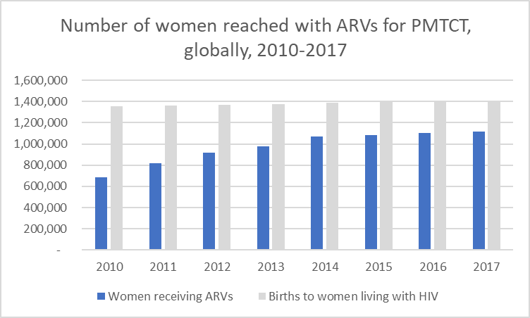
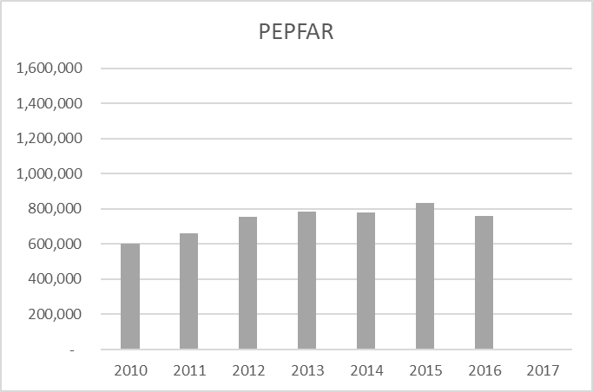
Scale up of PMTCT has slowed
Source: UNAIDS 2018 estimates. PEPFAR dashboard.

Slide 5
Close the gap in all countries and regions
93%
80%
48%
Source: UNAIDS 2018 estimates.

Slide 6
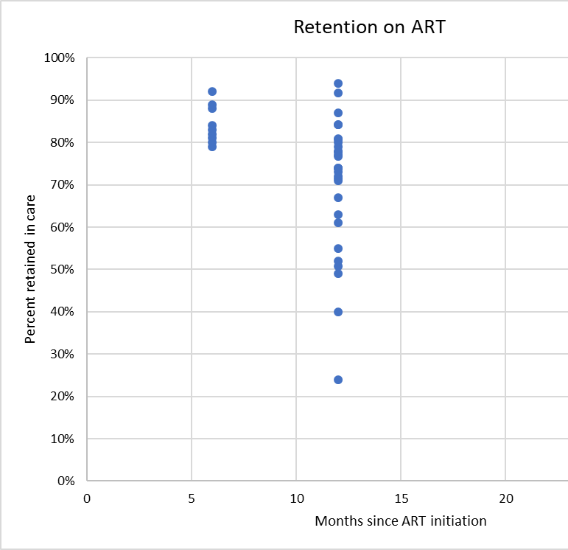
PMTCT “coverage …” includes women who drop out
A woman counted as receiving PMTCT does not guarantee viral suppression at delivery
Literature review of retention among women around the time of pregnancy found:
9 month retention among pregnant women already on ART: 75%
6 month retention among women initiating ART during pregnancy: 80%
Need viral suppression at delivery

Slide 7
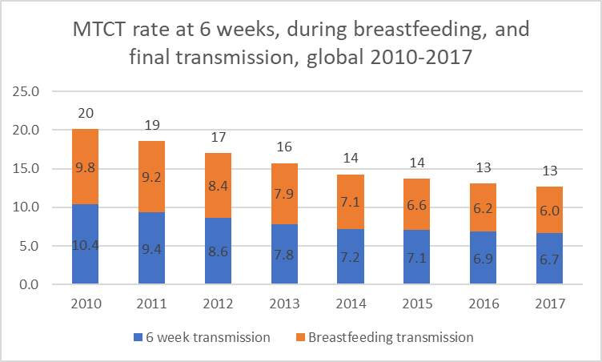
MTCT rates remain unacceptably high
Source: UNAIDS 2018 estimates.

Slide 8
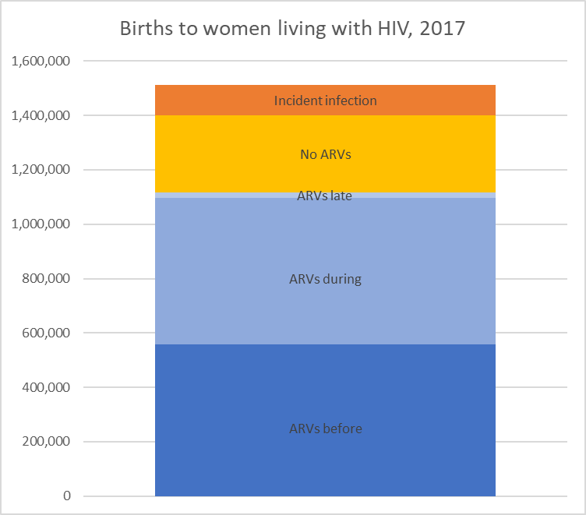
Among pregnant women living with HIV…
1.4 million pregnant women living with HIV
560,000 are on ART before pregnancy
530,000 are started on ART at 14 weeks
20,000 are started on ART just before delivery
280,000 do not get any ARV
115,000 women seroconvert
39,000 seroconvert during pregnancy
75,000 seroconvert during 17 months of breastfeeding
Source: UNAIDS special analysis of 2018 estimates

Slide 9
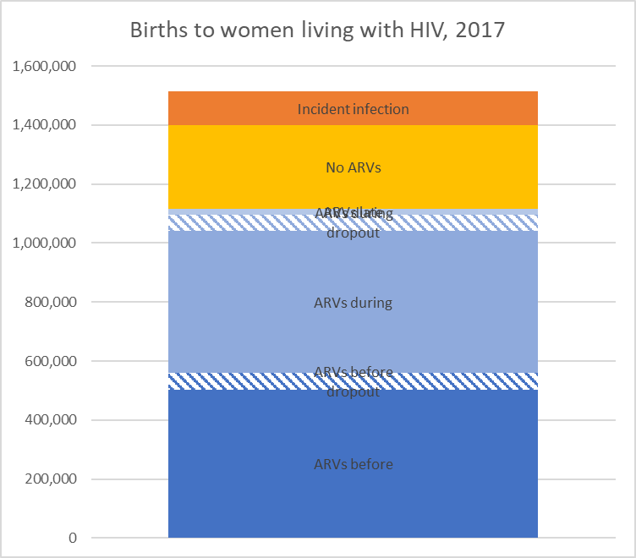
Among pregnant women living with HIV…
1.5 million pregnant women living with HIV
560,000 are on ART before pregnancy
530,000 are started on ART at 14 weeks
20,000 are started on ART just before delivery
280,000 do not get any ARV
110,000 will drop off of ART
115,000 women seroconvert
39,000 seroconvert during pregnancy
75,000 seroconvert during 17 months of breastfeeding
Source: UNAIDS special analysis of 2018 estimates

Slide 10
Among children newly infected …
Infections during breastfeeding | Number | Percent
Mom seroconverted during breastfeeding | 20,000 | 11%
Mom received no ARV | 19,000 | 11%
Mom dropped off ART | 16,000 | 9%
Mom started ART during pregnancy | 12,000 | 7%
Mom started ART before pregnancy | 1,000 | 1%
Mom started ART just before delivery | 600 | 0.4%
Infections during pregnancy
Mom seroconverted during pregnancy | 8,500 | 5%
Mom received no ARV | 74,000 | 42%
Mom dropped off ART | 13,000 | 7%
Mom started ART during pregnancy | 10,000 | 6%
Mom started ART before pregnancy | 2,000 | 1%
Mom started ART just before delivery | 1,500 | 1%
Total | 180,000 | 100%
Source: UNAIDS special analysis of 2018 estimates

Slide 11
Programmatic implications?
Programmatic goal | Number of infections averted | % of infections that could be averted | IMPLICATIONS Number of women to reach
if pregnant and breastfeeding women were protected from new infection and remained HIV negative | 30,000 | 17% | 115,000
if all women living with HIV not on treatment received ARVs | 95,000 | 54% | 280,000
if women were identified as HIV+ earlier in pregnancy | 2,000 | 1% | 20,000
if women had been on ART before conception | 20,000 | 11% | 480,000
… and were retained on ART | 30,000 | 17% | 110,000
If regimens were completely effective | 3,000 | 1.5% | 1,400,000
Source: UNAIDS special analysis of 2018 estimates

Slide 12
Acknowledgements
John Stover
Mahesh Mahalingan
Deborah von Zinkernagel

Slide 13
Future directions
Deborah von Zinkernagel
Director
Community Support, Social Justice and Inclusion Department
UNAIDS, Geneva

Slide 14
Picking up the pace
The Basics:
o primary prevention! Tailored strategies
o access to family planning, S/RH information
o testing, ART for HIV+ women before pregnancy
Antenatal care
o increased risk of HIV acquisition during pregnancy, postpartum
o supporting HIV negative women to stay negative
- information, support
- partner status
- PrEP option for high risk
Notes:
Tailored strategies – different ages, address different risks and vulnerabilities of girls, and women in the contexts of their lives
Access to information on sexual and reproductive health important for adolescents and women to have,
Access to family planning – 44% of pregnancies are unplanned (Lancet Global Health 2018, Bearak)
Rates of HIV transmission are lower for women on ART before conception – better for their health, and outcome for their infant
Greater risk of HIV acquisition when exposed to HIV, rising 2 fold early pregnancy to almost 3 fold late pregnancy and 4 fold higher risk during 6 months postpartum
Information and support – do not forget the HIV negative woman, who needs information and support also. For women who are married, it can be more difficult to request a partner to use condoms
Partner status – many women coming for ANC do not know the HIV status of partner, and therefore don’t know their risk. Strategies to engage male partners in taking an HIV test are varied, may include a test at a facility or possibly self-testing at home

Slide 15
Picking up the pace
Testing
o repeat testing during pregnancy/at delivery
o while breastfeeding
- self-testing options
- at child health visits
Retention in care
o models for community, peer-led support
o information systems to recognize lapse in care
Notes:
WHO guidelines support repeat testing during pregnancy, and at intervals during breastfeeding. A woman negative at 6 months may be HIV+ at delivery, and risks of transmission are highest during acute infection when viral load is high
Retention in care: many models of peer-led support and community support through groups of women living with HIV. What is vital to recognize is the importance and different need for support, enabling women to address family/community issues and stay engaged in care

Slide 16
Saving lives of young children
Accelerating early infant diagnosis
o test within 4-6 weeks of age
o rapid turnaround of results, ART initiation for HIV+ infant
o Point of care testing - shows strong results
Monitoring cascade of care for continuous improvement
o where are the gaps, when do new infections occur, to whom
o recognizing barriers, listen to young women and mothers
o communities, health providers contribute to solutions
Notes:
POC testing – and variations on this that work effectively with laboratory systems to ensure that whatever testing strategy is pursued allows for the rapid turnaround of results so they can be acted upon

Slide 17
Political Leadership, Advocacy
Renew momentum, commitment
OAFLA – AU continental campaign Free To Shine
o end new infections in children, keep mothers healthy
o country-level strategies, coordination
o address stigma, people at the center
o accountability for results
Path to Elimination, WHO validation
…….. not on the last mile, but we could be

